Slide 1
SAMPLING METHOD
PREPARED AND PRESENTED
BY
MRS BADJIE

Slide 2
Sample and sampling methods
Research is about drawing conclusions with regard to populations
It would be too costly, time-consuming, impractical to observe the whole population and it is usually not necessary
The objective of sampling is to draw a sub-set of the population that is truly reflective and indicative of the characteristics of the population

Slide 3
Cont
Sample drawn needs to be representative of population
Results from a biased sample cannot be generalized to the population

Slide 4
Terminology
Population - total group of units or subjects of interest
Sample- a subset of the population
Sampling unit- basic unit around which sampling is planned, usually a person
Sampling frame- list of all sampling units in the population e.g. electoral roll, telephone directory
Target/Reference population-population that you would like to draw conclusions about

Slide 5
Cont
Study/sources population-population from which the sample will be drawn
Selected sample-group of subjects selected for observation
Sample obtained-group of subjects for whom measurements are obtained
Sampling: Is a process of selecting a small number of elements from a large defined target group of elements such that the information gathered from the small will allow judgments to be made about the larger group

Slide 6
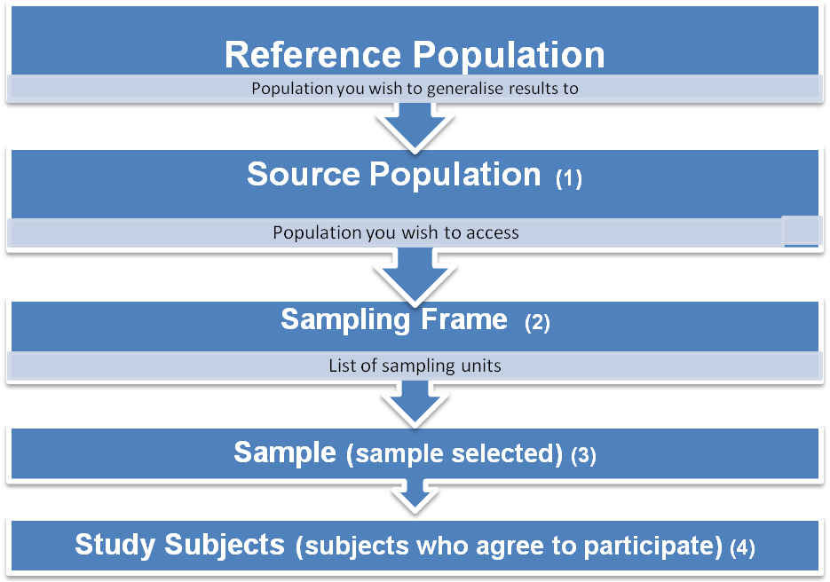
The Sampling Process

Slide 7
Sampling Methods
A number of sampling strategies are commonly used in research
The choice of one specific strategy over another often depend on many factors:
The objectives of the study
The study design
Available resources
The relative cost and benefit of the different methods should be weighed carefully

Slide 8
Cont
Sampling strategies are grouped into two major categories:
Probability sampling
Non probability sampling
A probability sampling means that each individual in the target population has a chance of being part of the sample

Slide 9
Cont
Non probability sampling means that either some groups of the target population have no chance of being sampled or their chance of being sampled cannot be accurately determine
For the purpose of this lecture, the presentation will focused on probability sampling techniques.
It will describe the types, steps involved , their weaknesses and strengths.

Slide 10
Probability sampling
Types
Simple random sampling
Stratified random sampling
Systematic random sampling
Cluster sampling

Slide 11
Simple random sampling
Simple random sampling is the most recognized probability sampling procedure
Is theoretically the most straightforward way of obtaining a sample that represents the target population
Simple random sampling gives every element in the target population, and each possible sample of a given size, an equal chance of being selected.

Slide 12
Steps in selecting a simple random sample
Define the target population
Identify an existing sampling frame of the target population or develop a new one
Assign a unique number to each element in the frame
Determine the sample size
Randomly select the targeted number of population elements.

Slide 13
Cont
Three techniques are typically used in carrying out Step 6:
the lottery method
A table of random numbers

Slide 14
87172 | 43062 | 39719 | 10020 | 32722 | 86545 | 86985 | 04962 | 54546 | 23138 | 62135 | 55870 | 97083 | 67875
28900 | 50851 | 30543 | 89185 | 16747 | 95104 | 49852 | 26467 | 58869 | 79053 | 06894 | 23975 | 34902 | 23587
86248 | 71156 | 55044 | 13045 | 33161 | 95604 | 57876 | 23367 | 10768 | 78193 | 60477 | 70307 | 06498 | 48793
10531 | 51391 | 41884 | 69759 | 32741 | 70072 | 01902 | 96656 | 90584 | 59263 | 49995 | 27235 | 40055 | 20917
02481 | 90230 | 81978 | 39127 | 93335 | 74259 | 25856 | 52838 | 49847 | 69042 | 85964 | 78159 | 40374 | 49658
23988 | 13019 | 78830 | 17069 | 58267 | 69796 | 94329 | 34050 | 25622 | 55349 | 10403 | 93790 | 77631 | 74261
37137 | 47689 | 82466 | 24243 | 10756 | 54009 | 44053 | 74870 | 28352 | 66389 | 38729 | 80349 | 50509 | 56465
38230 | 82039 | 34158 | 90149 | 82948 | 60686 | 27962 | 39306 | 53826 | 47852 | 76144 | 38812 | 76939 | 03119
98745 | 08288 | 19108 | 84791 | 58470 | 59415 | 45456 | 44839 | 86274 | 25091 | 42809 | 56707 | 47169 | 95273
44653 | 58412 | 91751 | 14954 | 87949 | 81399 | 51105 | 29718 | 82780 | 11262 | 23712 | 99782 | 42829 | 26308
88386 | 66621 | 16648 | 19217 | 52375 | 05417 | 26136 | 05952 | 71958 | 25744 | 52021 | 20225 | 01377 | 47012
50660 | 58138 | 01695 | 69351 | 25445 | 20797 | 74079 | 60851 | 47634 | 36633 | 93999 | 96345 | 58484 | 12506
36732 | 74234 | 84240 | 46924 | 62744 | 39238 | 78397 | 60869 | 26426 | 55588 | 56963 | 59506 | 17293 | 45096
34187 | 78277 | 83678 | 34754 | 46616 | 45250 | 25291 | 04999 | 19717 | 60324 | 66915 | 03473 | 98329 | 82447
26095 | 98131 | 79362 | 39530 | 53870 | 87445 | 26277 | 90551 | 28604 | 39865 | 40686 | 05435 | 74511 | 69866
00067 | 74289 | 20706 | 74076 | 28206 | 36960 | 09231 | 82988 | 57062 | 35331 | 08212 | 68111 | 52199 | 05065
42104 | 26434 | 30953 | 15259 | 76676 | 63339 | 75664 | 23993 | 63538 | 34968 | 47655 | 44553 | 61982 | 13296
82580 | 46580 | 87292 | 23226 | 21865 | 60338 | 04115 | 33807 | 38395 | 98484 | 40387 | 69877 | 24910 | 13317
89266 | 14764 | 17681 | 68663 | 66030 | 12931 | 17372 | 35601 | 63805 | 55739 | 42705 | 30549 | 31697 | 33478
47100 | 92329 | 89435 | 69974 | 40783 | 52649 | 93444 | 41317 | 02749 | 19052 | 34647 | 92814 | 88046 | 34020
59566 | 26527 | 44706 | 85670 | 96223 | 36275 | 82013 | 82673 | 60955 | 62617 | 90214 | 24589 | 59715 | 57612
10946 | 24676 | 66513 | 56743 | 96911 | 89042 | 08263 | 70753 | 89045 | 39189 | 04306 | 06090 | 94515 | 17772
34013 | 69250 | 27977 | 84597 | 55192 | 65088 | 55739 | 35953 | 18533 | 39339 | 78037 | 32827 | 68269 | 69218
21606 | 11751 | 30073 | 71431 | 53569 | 27865 | 90215 | 34772 | 21779 | 11734 | 64313 | 49764 | 30816 | 56852
56620 | 92612 | 77157 | 90231 | 90144 | 29781 | 01683 | 52503 | 60080 | 73703 | 70080 | 80686 | 47379 | 33279
49238 | 90475 | 84356 | 87159 | 21222 | 40106 | 02671 | 52684 | 38514 | 68434 | 16407 | 58164 | 13341 | 48142
50738 | 21999 | 73539 | 51802 | 78179 | 27872 | 57937 | 29696 | 67783 | 29373 | 96563 | 74619 | 77099 | 17190
58761 | 21571 | 71692 | 19723 | 25088 | 10483 | 71430 | 47068 | 78378 | 80237 | 32113 | 09381 | 62931 | 29243
55335 | 71937 | 22025 | 33538 | 04648 | 74232 | 57839 | 62431 | 61835 | 04784 | 06732 | 34202 | 93497 | 72070
26515 | 31143 | 83795 | 78445 | 32869 | 31489 | 81587 | 90354 | 97672 | 70106 | 35008 | 37899 | 36246 | 97805
32625 | 36806 | 00082 | 26902 | 26250 | 28919 | 38054 | 49027 | 22209 | 42696 | 46980 | 17065 | 61288 | 30208
20311 | 96089 | 20141 | 30362 | 04980 | 32703 | 04202 | 91080 | 28660 | 89691 | 84660 | 73433 | 70169 | 11273
10941 | 73003 | 87930 | 85620 | 06956 | 38719 | 88711 | 61454 | 64076 | 13316 | 02203 | 54437 | 54306 | 78229
56982 | 46636 | 34070 | 30803 | 39095 | 80387 | 08971 | 25067 | 07377 | 70704 | 13629 | 68474 | 99229 | 05535
14661 | 10670 | 15811 | 00454 | 81124 | 46977 | 89983 | 48836 | 48182 | 17054 | 06344 | 24267 | 16686 | 21401
52760 | 78118 | 23277 | 29760 | 00099 | 97325 | 54762 | 43117 | 73199 | 19621 | 24599 | 11030 | 64809 | 35088
48874 | 20831 | 02286 | 73635 | 93771 | 54264 | 49801 | 22653 | 01524 | 84621 | 91023 | 64028 | 29278 | 15987
44817 | 77408 | 48447 | 25934 | 22912 | 43086 | 68126 | 92970 | 91833 | 26418 | 72454 | 97636 | 94593 | 07880
17896 | 79375 | 70883 | 70135 | 21589 | 51181 | 71969 | 32951 | 35036 | 17219 | 27357 | 96517 | 55307 | 84470
27166 | 22347 | 92146 | 92189 | 16301 | 15747 | 72837 | 59174 | 75024 | 39459 | 54910 | 95335 | 95013 | 47068
13665 | 30490 | 63583 | 73098 | 19976 | 03001 | 94645 | 40476 | 43617 | 85698 | 66512 | 42759 | 20973 | 98759
58644 | 73840 | 08103 | 97926 | 57340 | 63077 | 08114 | 10031 | 35668 | 21740 | 33787 | 44756 | 20527 | 65367
72570 | 36278 | 06602 | 56406 | 85679 | 85529 | 08576 | 50874 | 59706 | 01019 | 29980 | 56742 | 05356 | 04810
92041 | 68829 | 02163 | 59918 | 83041 | 71241 | 90678 | 79835 | 86324 | 13075 | 29913 | 99831 | 25688 | 53648
71240 | 74119 | 53090 | 23693 | 14007 | 90107 | 68804 | 54927 | 68964 | 26535 | 28184 | 21630 | 12362 | 67990

Slide 15
17/13*/9 2/75/84/ 25*/29*/6 5/13/50*/ 61/66/4 3/78/93/ 44/14/3 4*/26/77/
28/29/7 1/42*/80/ 54/52/4 2/16/18 95/32/0* 3/ 81/74 / 60/57/9 9/49/99/
08/90/8 0/93/31/ 56/71/2 0/62/89/ 75/34/5 0/38/11/ 82/71/1 2*/52/52/
31/29/5 0/42/04/ 93/71/2 5/12/87/ 05/75/4 1/55/60/ 15/56/0 0/99/61
17; 13;25; 29; 50; 43; 44; 14; 34; 26; 28, 42; 16; 18; 32; 03; 49; 08; 31; 20; 38; 12; 31; 04; 05; 41; 15; ................................

Slide 16
Cont
Randomly generated numbers using a computer program (i.e., random number generator)

Slide 17
Strengths
Simple random sampling has the major strengths when compared to nonprobability sampling
Among its strengths are, it tends to yield representative samples, and allows the use of inferential statistics in analysing the data collected.

Slide 18
Cont
Advanced additional information on the elements in the population is not required. Such information is required for other probability sampling procedures, such as stratified sampling.
Each selection is independent of other selections, and every possible combination of sampling units has an equal and independent chance of being selected.

Slide 19
Cont
It is generally easier than other probability sampling procedures (such as multistage cluster sampling) to understand and communicate to others.
Statistical procedures required to analyze data and compute errors are easier than those required of other probability sampling procedures.
Statistical procedures for computing inferential statistics are incorporated in most statistical software and described in most elementary statistics textbooks.

Slide 20
Weakness
A sampling frame of elements in the target population is required.
An appropriate sampling frame may not exist for the population that is targeted, and it may not be feasible or practical to construct one.
Simple random sampling tends to have larger sampling errors and less precision than stratified samples of the same sample size.

Slide 21
Cont
Respondents may be widely dispersed; hence, data collection costs might be higher than those for other probability sample designs such as cluster sampling.
Simple random sampling may not yield sufficient numbers of elements in small subgroups.
This would not make simple random sampling a good choice for studies requiring comparative analysis of small categories of a population with much larger categories of the population.

Slide 22
Stratified random sampling
Stratified sampling is a probability sampling procedure in which the target population is first divided into subpopulations called (strata), and then a simple random sample is selected from each segment (stratum)
The elements within the stratum should be homogenous (similar) but those in different strata are heterogeneous (different)
The stratification may base on a wide variety of attributes such as age, gender, occupation, socioeconomic status ect

Slide 23
Steps in selecting a stratified random sample
Define the target population
Identify stratification variable(s) and determine the number of strata to be used
The stratification variables should relate to the purposes of the study
More than one stratification variable may be used (they should relate to the variables of interest in the study and be independent of each other)

Slide 24
Cont
Not more than four to six stratification variables and not more than six strata for a particular variable should be used.
Identify an existing sampling frame or develop a sampling frame that includes information on the stratification variable(s) for each element in the target population
Divide the sampling frame into strata, categories of the stratification variable(s), creating a sampling frame for each stratum
Assign a unique number to each element

Slide 25
Cont
Determine the sample size for each stratum
Randomly select the targeted number of elements from each stratum
Subtypes of Stratified Sampling
proportionate stratified sampling and disproportionate stratified sampling

Slide 26
Strengths
Ability to not only estimate population parameters, but also to make within-stratum inferences and comparisons across strata
Stratified samples yield smaller random sampling errors than those obtained with a simple random sample of the same sample size
Stratification will yield a sample that is at least as precise as a simple random sample of the same sample size

Slide 27
Cont
Stratified samples tend to be more representative of a population because they ensure that elements from each stratum in the population are represented in the sample
If the stratification variable breaks up the population into homogeneous geographical areas, data collection costs may be lower than the data collection costs of sample random sampling

Slide 28
Weaknesses
Stratified sampling has a greater requirement for prior additional information than is the case for simple random sampling
Selection of stratification variables may be difficult if a study involves a large number of variables
Stratified sampling requires more effort in terms of preparation for sampling, executing the sample design, and analyzing the data collected.

Slide 29
Cont
The analysis of data collected is more complex than the analysis of data collected via simple random sampling
Misclassification of elements into strata may increase variability.
More expensive, time-consuming, and complicated than simple random sampling

Slide 30
Systematic random sampling
Systematic sampling (or interval random sampling) is a probability sampling procedure in which a random selection is made of the first element for the sample, and then subsequent elements are selected using a fixed or systematic interval until the desired sample size is reached
The sample is chosen by selecting a random starting point and then picking every ith element in succession from the sampling frame

Slide 31
Steps in Selecting a Systematic Sample
Define the target population
Determine the desired sample size
Identify an existing sampling frame or develop a sampling frame of the target population
Determine the number of elements in the sampling frame (N).
Calculate the sampling interval (i) by dividing the number of elements in the sampling frame (N) by the targeted sample size (n)

Slide 32
Cont
i= N/n ( round the result to the nearest whole number)
The sample with n observations is then obtained by selecting every I
Randomly select a number, r, from “1” through i
Select for the sample, r, r + i, r +2i, r +3i, and so forth, until the frame is exhausted

Slide 33
Strengths
If the selection process is manual, systematic sampling is easier, simpler, less time-consuming, and more economical than simple random sampling
One needs to use a random process to select only the first element
Systematic sampling ensures that the sample is more spread across the population
The target population need not be numbered

Slide 34
Weaknesses
Principle of independence is violated, for the selection of the first element determines the selection of all others
Technically only the selection of the first element is a probability selection since for subsequent selections there will be members of the target population that will have a zero chance of being selected
  Need a sampling frame, but don’t need to know whole frame in advance

Slide 35
Cluster sampling
Is a method of probability sampling in which the population is first divided in to sub groups or clusters and then a random sample of clusters is selected by using simple random sampling technique.
For each selected cluster, either all the elements are included in the sample or a sample of elements is drawn from the cluster

Slide 36
Cluster sampling
The elements of the population are randomly selected in naturally occurring groupings (clusters)
In cluster sampling, a sample of clusters is chosen first and then people are sample from these clusters.
It can be use in large scale surveys

Slide 37
Cont
Depending on the research question, these clusters could be schools, day-care centres, suburbs, households or communities
Cluster sampling involves the selection of population elements not individually, but in aggregates
It is most commonly used in cross sectional studies

Slide 38
Steps in Selecting a Cluster Sample
Define the target population
Determine the desired sample size
Identify an existing sampling frame or develop a new sampling frame of clusters of the target population
Determine the number of clusters to be selected (this may be done by dividing the sample size by estimated average number of population elements in each cluster).
Randomly select the targeted number of clusters
Select sampling units within each selected cluster based on simple random sampling or systematic sampling

Slide 39
Strengths
If the clusters are geographically defined, cluster sampling requires less time, money, and labor than simple random sampling
Cluster sampling with a higher sample size may yield less sampling error than that resulting from simple random sampling with a smaller sample size.
Cluster sampling permits subsequent sampling because the sampled clusters are aggregates of elements.

Slide 40
Cont
Unlike simple random sampling, cluster sampling permits the estimation characteristics of subsets (clusters) as well as the target population
Cluster sampling is much easier to implement than simple random sampling
Cluster sampling does not require a sampling frame of all of the elements in the target population

Slide 41
Weaknesses
The sampled clusters may not be as representative of the population as a simple random sample of the same sample size
Cluster sampling introduces more complexity in analyzing data and interpreting results of the analyses

